Slide 1
Deploying a Movie Listing Website on AWS Cloud
Team Members
B. ABHISHEK
G. VAMSHIDHAR
T. RAMAREDDY

Slide 2
PURPOSE OF THE PROJECT
The aim of the project is to deploy a movie listing web application into the cloud so that it will allow users to connect from anywhere and also allows them to upload movie posters and details.
The website uses ReactJS at the front end, NodeJS at the back end, and MongoDB as the database.
The main objective of the project is to provide a platform for users to explore and discover new movies, as well as share their favorite movies with others.
The website is designed to be user-friendly and interactive, to help users easily find the movies they are interested in.
By deploying the website on the AWS cloud infrastructure with proper scaling, the project aims to provide a seamless and reliable experience for users, even during periods of high traffic.
One of the main advantages of this project is that it stores the data in multiple locations. So even when there is a loss of data at one place all the information will be made available at the other locations.
We can find that the data is being stored in the MongoDB database, S3 buckets, and docker.

Slide 3
TECHNOLOGIES USED IN THIS PROJECT
The following are the technologies that have been used in the project:
1)Database management:
MongoDB has been used as the database for storing movie details, user information, and other relevant data. MongoDB is a NoSQL database that is highly flexible.
2)File Upload:
The multer-s3 package extends the functionality of multi by providing the ability to store uploaded files directly to Amazon S3 (Simple Storage Service) instead of storing them locally on the server.
3)Cloud infrastructure:
We have used Amazon Web Services (AWS) for deploying the movie listing website on the cloud infrastructure with proper scaling. We have used the following services of AWS:
EC2: EC2 stands for Elastic Compute Cloud. It is a web service that helps to launch and manage virtual machines known as instances in the cloud. In this project, we used EC2 to host the “Movie Listing” website.
S3: S3 stands for Simple Storage Service. It is a highly scalable, durable, and secure object storage service. S3 is used to store and retrieve any amount of data from anywhere on the web
ELB: ELB stands for Elastic Load Balancer. ELB automatically distributes the incoming traffic across multiple Amazon EC2 instances, helping to improve the availability and scalability of applications running on AWS. In our project, we have used a Network load balancer for the distribution of traffic to multiple EC2 instances.

Slide 4
MAJOR TOOLS AND SERVICES UTILIZED IN THIS PROJECT
Visual Code: Visual Studio Code, commonly referred to as VS Code, is a free, open-source code editor developed by Microsoft. It is a lightweight and powerful tool for coding, debugging, and building applications. We have used it to write the codes of the front end and back end.
MongoDB: A NoSQL database used for storing movie details, user information, and other relevant data.
ReactJS: A JavaScript library used for building user interfaces and developing the front end of the movie listing website.
NodeJS: A JavaScript runtime environment used for developing the backend of the movie listing website.
Figma: Figma is a cloud-based design and prototyping tool that allows designers and teams to collaborate on designing user interfaces, web pages, and mobile applications. It is used to design the architecture that has been followed.
Docker: Docker has been used to containerize the application by creating Docker images. We have built Docker images for both the front end and back end and they are made to run in the instances.

Slide 5

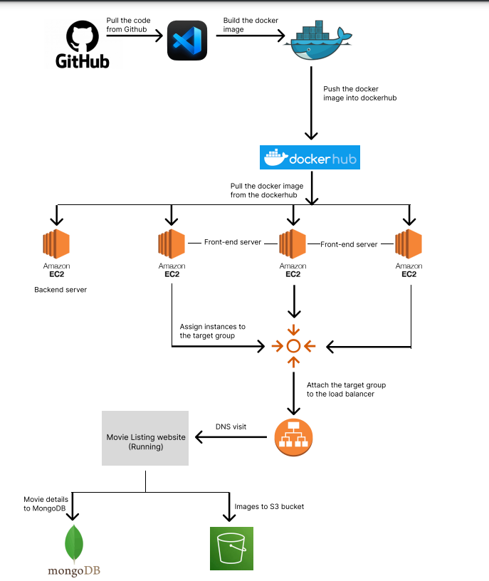
DEPLOYMENT DIAGRAM

Slide 6
IMPLEMENTATION:
Initially, we cloned the Movie listing website which uses ReactJS as frontend, NodeJS as backend and MongoDB as database from the repo:
Step 1: MongoDB Atlas Account creation and connection through Server.
Here, we create MongoDB account and create a free tire cluster and given network access as allow access from anywhere and create the cluster.
After creation of the cluster then connect it. Here we able to see the connection link.
Now we must connect the server side with MongoDB, to achieve this we replace the local host link with the connection link where it is found in cluster.

Slide 7
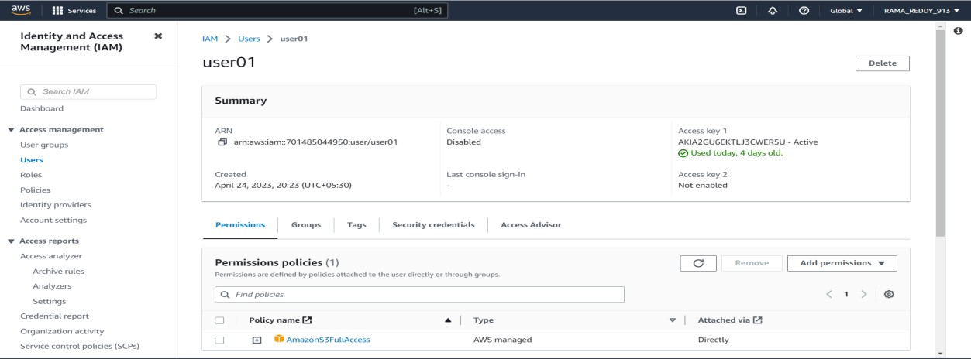
Step2: Creation of s3 bucket for storing images and IAM user for necessary permissions.
Here, we create s3 bucket and given the bucket policy and after we create IAM user and giving s3fullacess permission and we generate an access key.

Slide 8
Step 3: Now time to change the backend code. For further implementation.
After creating the bucket, update the code to use the multer-s3 library to upload the movie images to the S3 bucket. Multer-s3 is a middleware that extends the multer package, which is used for handling file uploads in Node.js. It allows you to upload files directly to AWS S3 instead of using local storage.
In the backend code, you need to replace the existing multer code with multer-s3 configuration. Multer-s3 requires AWS access keys and the S3 bucket name to
configure. You can obtain the access keys from the AWS IAM console.
Step 4: Creation of docker file for image creation in the server.
To create and push the images we must include the docker file. To build an image the docker desktop is running on background and build the image and push it into the docker hub.

Slide 9
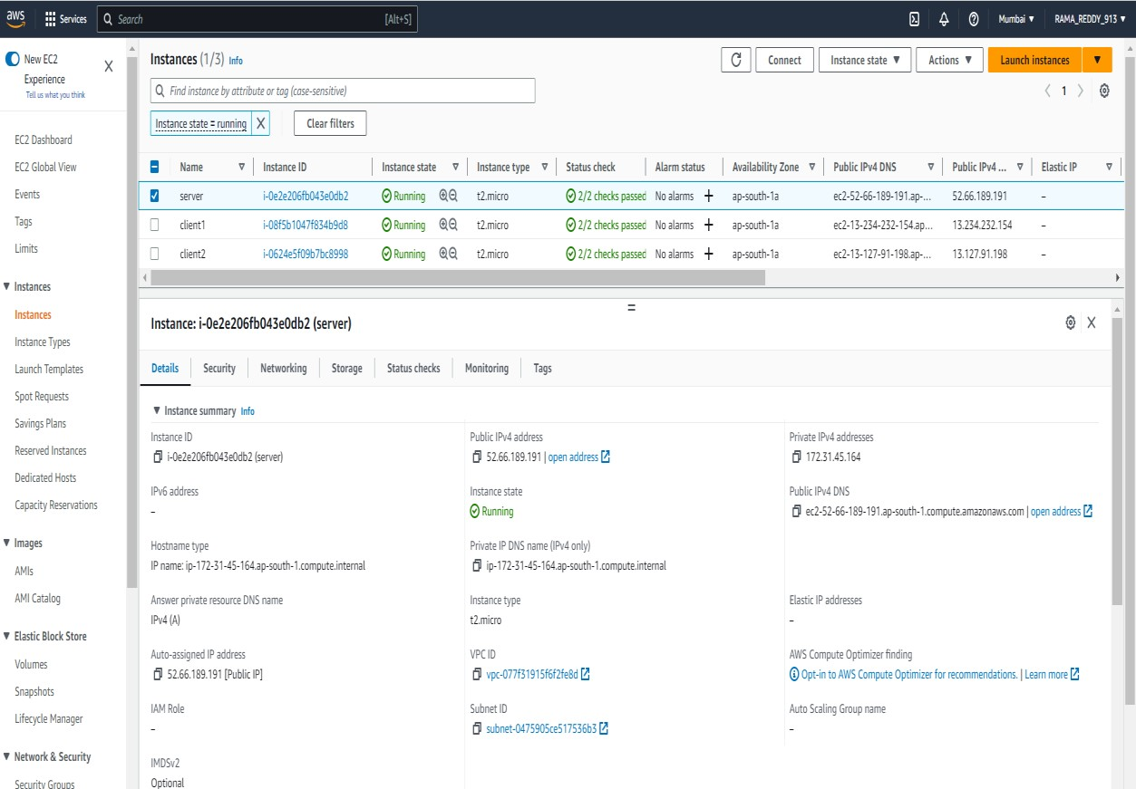
Deploy
Deploy Backend in EC2 instance:
Launch
Launch an EC2 instance and configure it with the required dependencies and packages.
Build
Build a Docker image for the NodeJS backend application and push it to AWS ECR or Docker Hub.
Deploy
Deploy the Docker image on the EC2 instance using Docker.

Slide 10
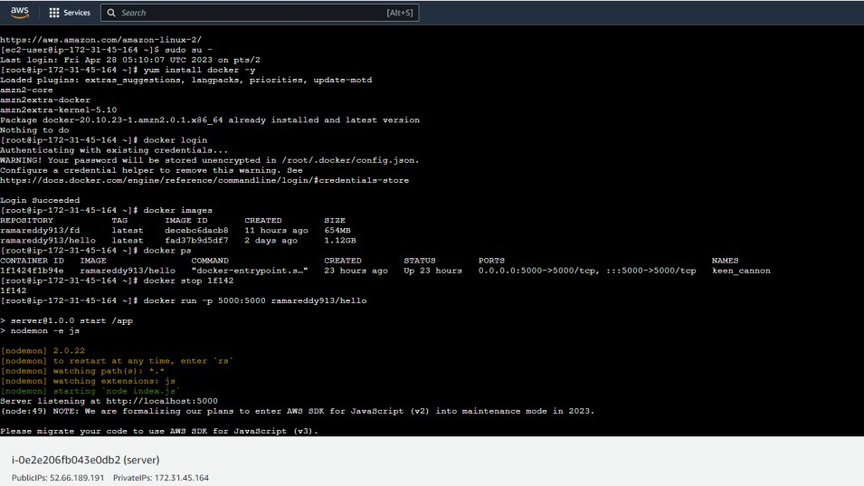
Connect EC2 instance and move to root user and install all necessary plugins and install docker in the
Instance and use docker login command to login into our docker hub account and use the command
docker pull <user name>/<image name> command to pull the image.
Now run the image using the command docker run -p 5000:5000 <username>/<image name>
After executing the command, it shows it is connected to MongoDB.

Slide 11

Step 6: Modify Frontend to fetch data from Backend
To modify our frontend to fetch data from your backend, you need to update the
frontend code to make API calls to the backend running on the EC2 instance. You can use the Axioms library to make HTTP requests from your React.js application to your Node.js backend.
After updating the code, you need to build a Docker image for your React.js frontend application and push it to AWS ECR or Docker Hub. You can then deploy the Docker image on the EC2 instance using Docker.
Launch an EC2 instance and configure it with the required dependencies and packages.
Here install docker in root user. First move to root user using the command sudo su -.
Now install the docker by using the command yum install docker -y.
Now pull the image using push command and rum the image using the command docker run -p 3000:3000 <user name>/<image name>

Slide 12
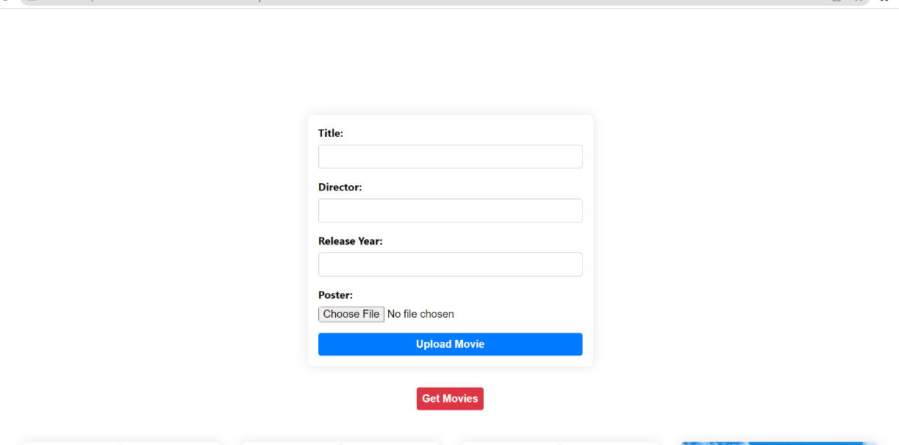

Slide 13
Step 7: Create Target group and load balancer.
Now Specify the group details as select the instances because we are doing the whole process using the ec2 instances and name the target group and select the protocol as TCP and port number as 3000, because we are run the images on the port 3000 and register the targets (client) and create the target group.
Create the load balancer which is used to increase capacity (concurrent users) and reliability of applications. Here we create load balancer for server and client. Now we get a DNS (Domain Name System).

Slide 14
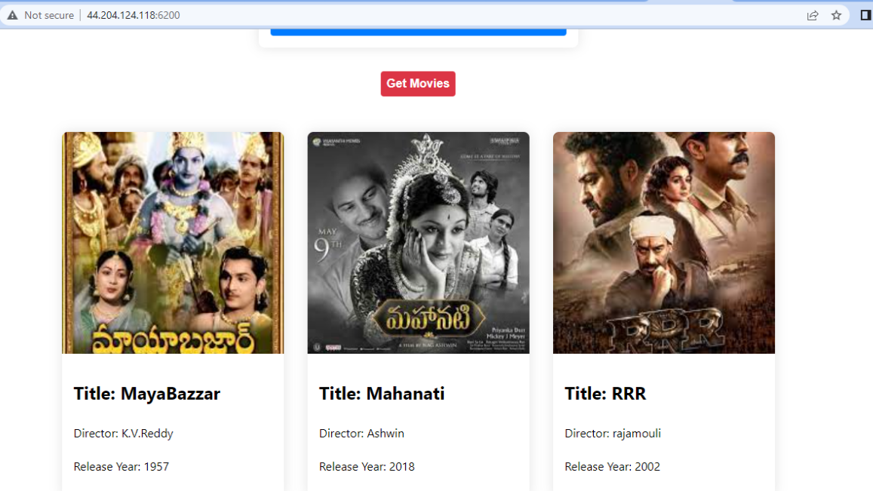
Step 8: Use DNS to point to the load balancer
Here we update the existing one to point to the load balancer's DNS name.

Slide 15
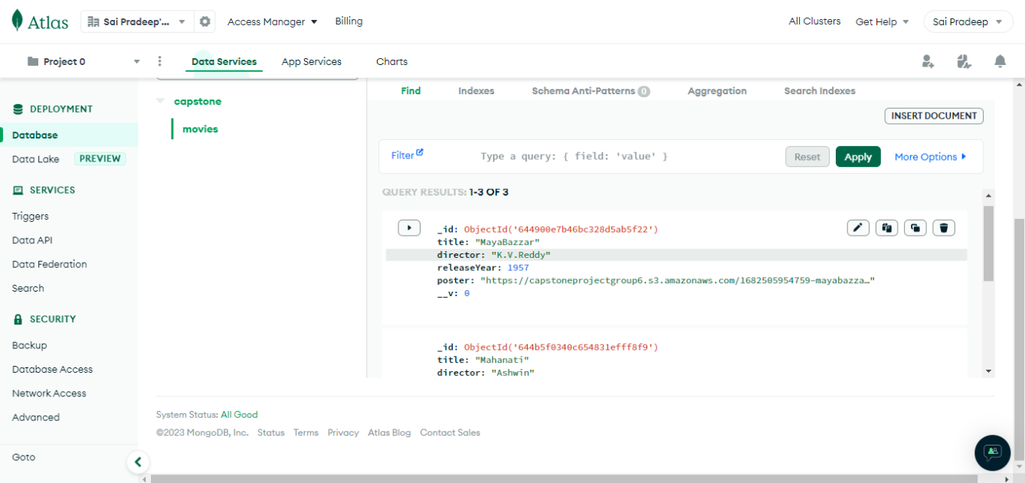
DATABASE AFTER UPLOADING MOVIE DETAILS

Slide 16
THANK YOU

